Slide 1
Social Media and Hotel Marketing
Holly Waisanen-Hatipoglu
19 May 2014

Slide 2
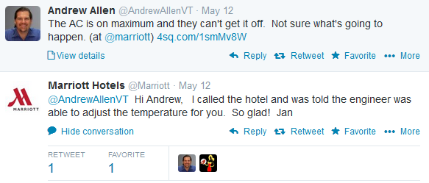
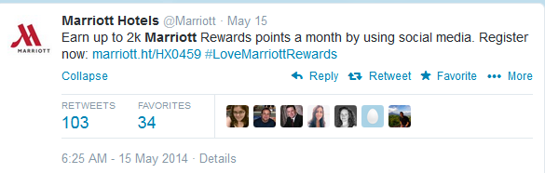
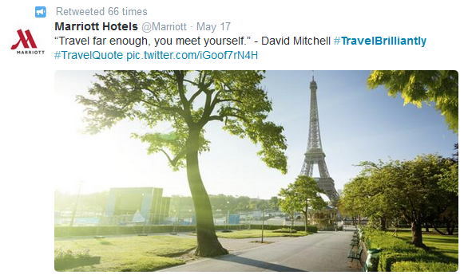
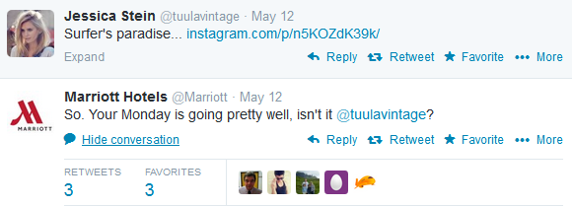
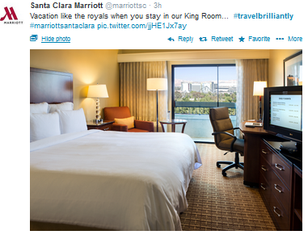
Brands are using social media to connect with customers in many ways – example: hotel industry
Customer service / monitoring
Building brand engagement
Question: How are different hotel brands engaging on Twitter
and what is the customer response?

Slide 3
Technical Overview – Capturing, scrubbing, and visualizing tweets
Ran Python script using TwitterAPI library to capture tweets on AWS EC2 Micro instance for 3+ weeks
First set up permissions to access Streaming Twitter API
Filter selects keywords for a few top brands – Marriott (and Renaissance), Hilton (and HHonors), Starwood (and SPG, W and Westin) , IHG, Hyatt
Ended with 418K+ tweets (1.4GB) between Apr 20-May 11
Scrubbed Twitter output in Python to extract most relevant fields, consolidate file size, and run initial summary metrics
Exported a pandas dataframe to a csv for use in R and Tableau for further analysis and visualization
Twitter API processing – if I can do it, you can too

Slide 4
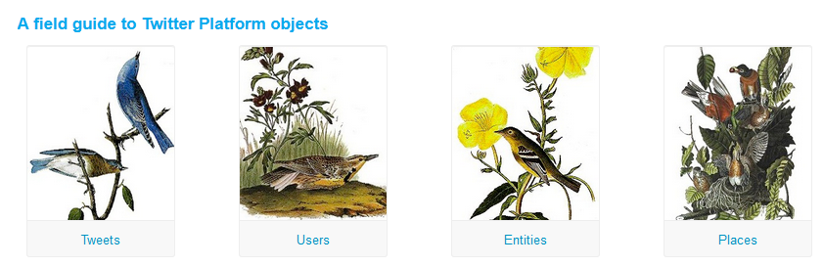
Twitter API – so many tweets!
REST API vs. Streaming
REST – based on user request or interaction with an app (e.g. Twitter widget on a blog), focus on simplicity and relevance – not exhaustiveness
Streaming – maintains a persistent connection and return everything, most relevant for large scale capture
Both require OAuth and application setup, have similar filtering capabilities (for GET, at least), and return similar objects
Various libraries and packages exist in Python and R to query and process JSON strings, e.g. TwitteR, StreamR, TwitterAPI
Extensive documentation at Twitter on object structures
https://dev.twitter.com/docs

Slide 5
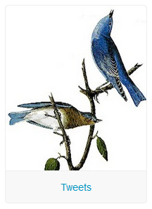
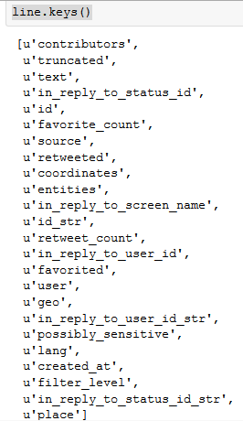

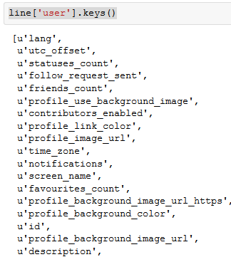
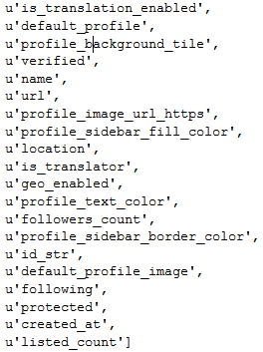
Twitter API – so much info in each tweet!

Slide 6
My top GADSDC learning - never underestimate the challenge of data manipulation
Filtering irrelevant data
Paris / Perez, SPG, last names. . .
Counting retweets
Text scrubbing
Lower, Punctuation/Numbers, Stemming, Stopwords, …
Computing sentiment
Pseudo-Bayesian method to count instances of positive and negative words from pre-scored dictionaries
Time / date scrubbing
Data structures for more advanced analytics
Term Document Matrix, TFIDF --> not trivial or quick!

Slide 7
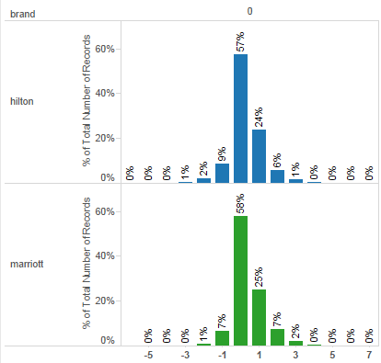
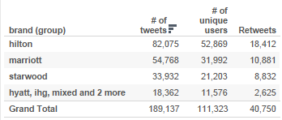
Top level engagement - which brands have the most volume and most positive sentiment?
Hilton has the most tweets, retweets and unique users in current tweet set
Marriott has subtly more
positive sentiment
Question: Is this representative of hotel related tweets or is there more scrubbing to be done?
Sentiment = # pos words - # neg words

Slide 8
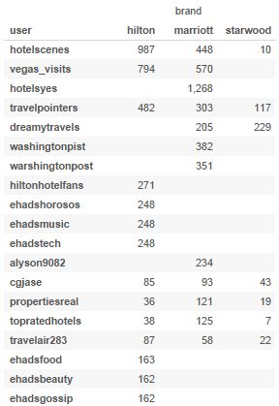
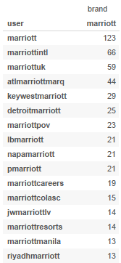
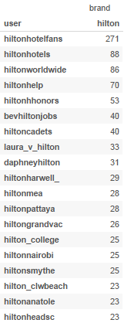
Users - Who is actually doing all this tweeting?
Travel aggregators tweet the most – but entertainment related tweeters suggest more cleaning to do!
Hotel brand tweeters show mix of corporate and property-level tweeters (and more cleanup needed)

Slide 9
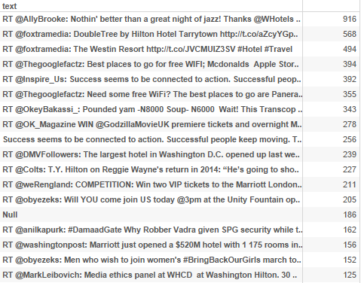
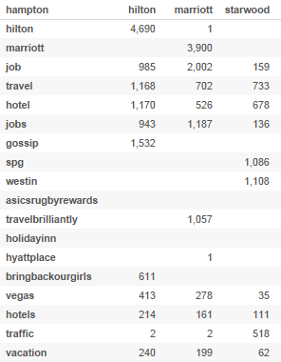
Content –What’s being retweeted? Which hashtags are catching on?
Retweets driven by beautiful pictures, inspirational quotes, twitter sweepstakes, and news items (some unrelated)
Top hashtags are brand names, “job(s)”, travel words, and some promo tags
# of retweets
Hashtag

Slide 10
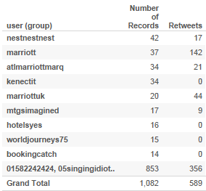
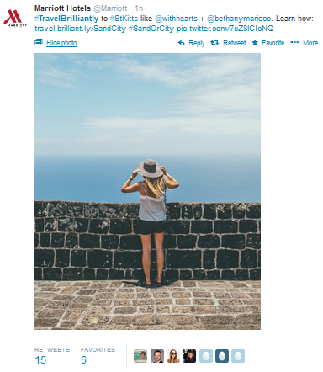
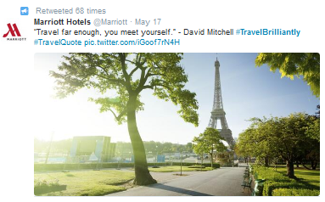
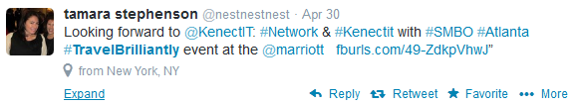

Deep dive on #TravelBrilliantly
Travel Brilliantly is Marriott’s current rebranding campaign
Biggest volume of tweets using #TravelBrilliantly come from Marriott and paid affiliates – but how can we dig into the tail to identify meaningful value for individual customers?

Slide 11
Learnings and Next Steps
Social media processing is no joke – whole papers can and have been written on scrubbing Twitter data
Think carefully about streaming vs batch processing and data structures for scalable text analysis
Next steps – that script is still running...
More sophisticated sentiment analysis
Clustering – detect types of tweets or users
Network analysis – who is influential
Extend streaming capabilities and add search terms, develop cadence around EC2 micro usage

